Slide 1





CyberShield
Training Module
Cybersecurity Awareness
Session Date
April 20, 2026
Phishing Awareness Training
Om Soni
omsoni9694@gmail.com

Slide 2
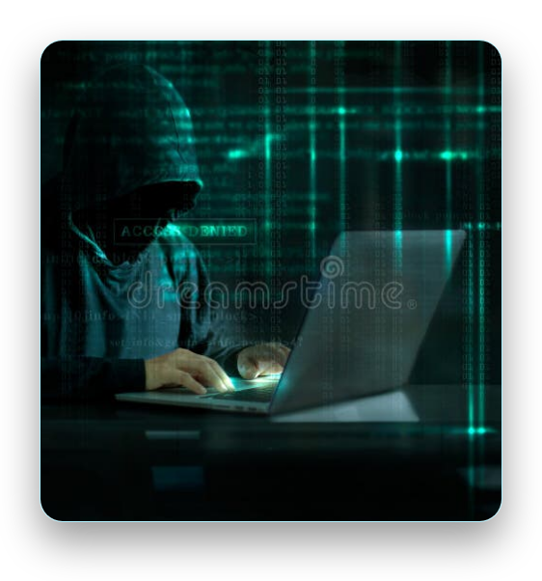
The Phishing Threat Landscape
Phishing is one of the most dangerous cyber threats in today's digital world
Attackers use fake emails, websites, and messages to steal sensitive information
Cybersecurity awareness is essential to protect personal and organizational data
Understanding phishing tactics is the first line of defense

Slide 3


Understanding Phishing Attacks
Phishing is a cyber attack where attackers trick users into sharing sensitive data
Primary Targets:
Passwords and login credentials
Bank details and financial information
Personal identification information
Attackers impersonate trusted organizations to gain unauthorized access
Deception is the core tactic used in all phishing attempts

Slide 4





Common Phishing Attack Methods
📧
Email Phishing
Fraudulent emails impersonating legitimate organizations
📱
Smishing
SMS text message attacks targeting mobile users
📞
Vishing
Voice call scams using phone conversations
🎯
Spear Phishing
Highly targeted attacks on specific individuals or organizations

Slide 5
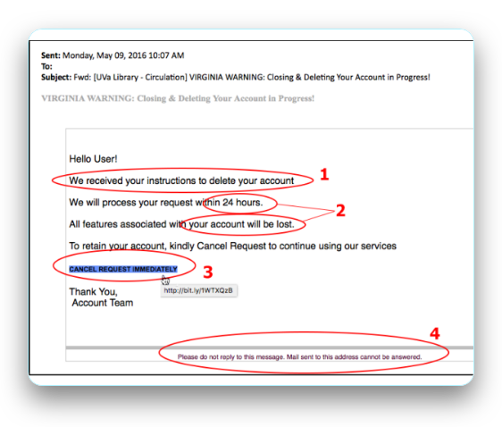

Recognizing a Phishing Attack
Example Message:
"⚠️ Your bank account is suspended. Click here to verify."
This message creates urgency and fear to manipulate users
Warning Signs to Identify:
Unknown or suspicious sender address
Suspicious or shortened link URL
Urgent or threatening tone
Request for immediate action
Always verify through official channels before responding

Slide 6
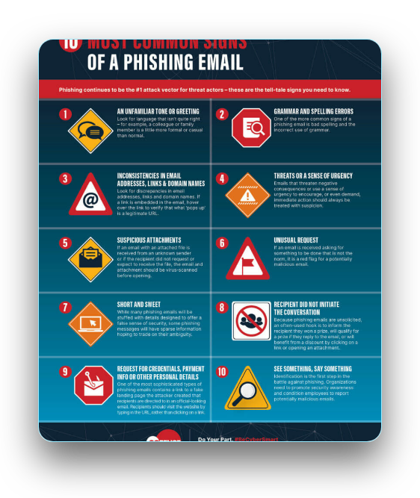


Detection Techniques
Carefully examine the sender's email address for inconsistencies
Look for spelling and grammatical mistakes in the message
Avoid clicking on unknown or suspicious links
Verify website security by checking for HTTPS protocol
Be cautious of messages creating false urgency
Hover over links to preview the actual destination URL

Slide 7


Red Flags to Watch For
Offers that seem too good to be true (free money, prizes, rewards)
Messages demanding urgent action or immediate response
Unexpected attachments from unknown sources
Communication from unrecognized or unverified senders
Requests for sensitive personal or financial information
Always verify the source before trusting any message

Slide 8
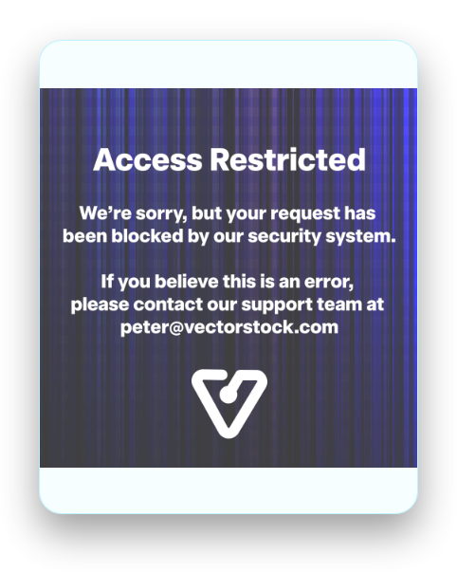
Protect Yourself from Phishing
Use strong, unique passwords for each account
Enable Two-Factor Authentication (2FA) wherever possible
Avoid accessing sensitive accounts on public Wi-Fi networks
Never share personal information via email or unsecured channels
Keep all software and security systems updated regularly
Install reputable antivirus and anti-phishing tools

Slide 9

Test Your Understanding
01
What is phishing and why is it dangerous?
02
Should you click on links from unknown senders?
03
What does 2FA stand for and why is it important?
04
How can you identify a fake or phishing email?
Take a moment to reflect on these questions

Slide 10
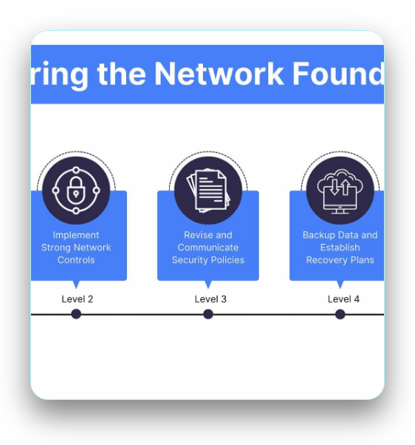
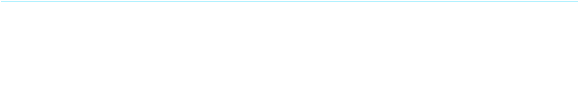
Stay Cyber Safe
Phishing attacks are increasing rapidly in the digital world
👉
Stay Alert
Always be vigilant about suspicious communications
👉
Think Before You Click
Verify before taking action
👉
Protect Your Data
Use security best practices consistently
Cybersecurity awareness is your first and strongest defense

Slide 11
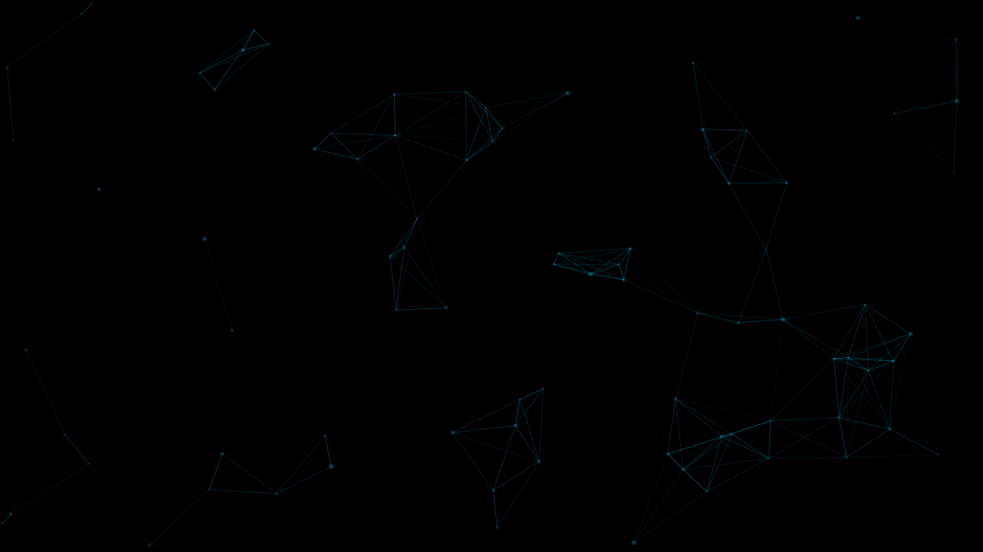
Phishing Awareness Training
Presenter:
Om Soni
Contact:
omsoni9694@gmail.com
Stay safe online and practice what you've learned
Thank You!
Questions?
Cybersecurity Awareness 2026

